Slide 1
WEB-SOBA: Word Embeddings-Based Semi-automatic Ontology Building for Aspect-Based Sentiment Classification
Fenna ten Haaf, Christopher Claassen,
Ruben Eschauzier, Joanne Tjan, Daniel Buijs,
Flavius Frasincar, and Kim Schouten
Erasmus University Rotterdam, the Netherlands
Notes:
My name is Ruben Eschauzier and I will present today WEB-SOBA, a Word Emebeddings-Based Ontology Building Approach for Aspect-Based Sentiment Classification. This is joint work with Fenna ten Haaf, Christopher Claassen, Joanne Tjan, Daniel Buijs, Flavius Frasincar, and Kim Schouten, all from Erasmus University Rotterdam, in the Netherlands.

Slide 2
Content
Motivation
Related Work
Data
Methodology
Evaluation
Conclusion

Slide 3
Motivation
Growing number of text data available
More specifically online reviews
Growing importance of reviews:
80% of the consumers read online reviews
75% of the consumers consider reviews important
Business can use the information to improve
Identify key strengths and weaknesses
Yelp alone features more than 200 million reviews
Notes:
With rise of the internet coincides with the rise in amount of data available to companies, universities and governments.
Text data such as online reviews contain a wealth of information
Reviews are also important for the consumer
Businesses can use reviews to identify and improve weaknesses of their product
Yelp 200 million reviews

Slide 4
Motivation
Automatic analysis of data required to generate insights
We focus on sentiment within reviews
Sentiment mining is defined as the automatic assessment of the sentiment expressed in text (in our case by consumers in product reviews)
Different types of sentiment mining
Review-level
Sentence-level
Aspect-level (for products, aspects are also referred to as product features)
Notes:
The amount of data is so vast that automation is required to create insight into our data and leverage it successfully. We focus on automating sentiment extraction in reviews
This is also known as sentiment mining, which is defined as …
Sentiment mining can be divided into many different types / layers
-Review level
-Sentence level
-Aspect-level / based
This is divided into review / sentence as well
We are interested in sentence level aspect-based sentiment mining

Slide 5
Motivation
Aspect-Based Sentiment Analysis (ABSA) aims to determine sentiment polarity regarding aspects of products
ABSA has two phases
Aspect mining attempts to extract aspects mentioned in text
There are two different aspect types
Explicit aspect mentions where the aspect is explicitly mentioned
Implicit aspect mentions, where the aspect is implied by the sentence
Three main approaches
Knowledge Representation
Machine Learning
Hybrid: current state-of-the-art, e.g., A Hybrid Approach for Aspect-Based Sentiment Analysis (HAABSA) proposed by Wallaart and Frasincar (2019) at ESWC 2019
Notes:
ABSA is useful to extract more information from text. Reviews can for example compliment the service but be negative about the food of a restaurant. Then ABSA can identify this and provide valuable insights.
Example explicit is: the food is great or the service was horrendous
Example implicit is: the car is fast
The knowledge Representation uses logic to represent information about the world. Examples of knowledge representation are semantic nets and ontologies
The statistical methods mainly use machine learning to find patterns in the way text expresses sentiment
Hybrid approaches combine knowledge representations and statistical methods to get the best of both worlds and obtain state-of-the-art results, like HAABSA proposed by Wallaart and Frasincar
(NOTE: I’m not sure if there is already more advanced or better working methods we should cite like for example lrc rot hop)

Slide 6
Motivation
HAABSA uses an ontology to predict sentiment
If that fails, use machine learning model as back-up
Ontology is hand crafted
Semi-automatic ontology building reduces user time spent
Word embeddings promising candidate to use as word representation
We propose a method for building ontologies semi-automatically based on word embeddings
Notes:
HAABSA uses an ontology to make predictions, this can fail due to either limited vocabulary or inconclusive results
A machine learning model is employed to predict sentiment when ontology fails
This ontology is hand crafted; this is a time-consuming process taking about 12 hours and has to be done for each specific domain we want to use it on
By building an ontology semi automatically we can reduce the time spent making an ontology while keeping much of the performance by using human input in certain steps.
In literature this is mainly done using word cooccurrences or Synsets, however word embeddings seem fit to use due to word vectors containing semantic information of words.
In this paper we propose a method for building ontologies semi automatically using the information contained in the word embeddings of input words

Slide 7
Related Work
Ontology+BoW approach is introduced in Schouten and Frasincar (2017)
Only ontology achieves 74.2% accuracy on SemEval 2016
Only BoW SVM achieves 82.0% accuracy
Ontology + BoW SVM achieves 86.0% accuracy
HAABSA combines an ontology with attentional neural model
Left-Center-Right separated neural network with Rotatory attention and multi-hops (LCR-Rot-hop) by Wallaart and Frasincar (2019) uses left, target and right context to compute attention scores in an iterative approach to mine sentiment.
Ontology + LCR-Rot-hop achieves state-of-the-art 88.0% accuracy on SamEval 2016
Notes:
One of the first examples of using an ontology together with a machine learning model is introduced in Schouten and Frasincar (2018). They use a BoW representation of sentences and apply SVM to any sentence that the ontology is not able to classify as positive or negative.
Ontology is limited due to the wide variety of ways sentiment can be expressed, thus by using both ontologies with carefully crafted features together with a statistical model trained on sentences the ontology is unsure about the two methods complement each other.
This is seen in accuracy: only ont 74.2%, only svm 82.0%, Ont + SVM 86.0%
New advances in machine learning involve attentional neural networks. HAABSA uses this to create a more advanced and accurate back-up model.
Left-Center-Right separated neural network with Rotatory attention and Multi-hops uses left, target and right context attention in an iterative approach. Furthermore, the input of this model are transformer-based word embeddings of the input sentence, which is able to encode context within the vectors.

Slide 8
Related Work
Buitelaar et al. (2005) propose a framework for creating ontologies
Three ingredients are needed
Terms: Words and their synonyms that portray either sentiment or aspects that are specific to our domain or are used for general use
Concepts: Terms that are related to each other need to be linked within the ontology to form concepts
Concept Hierarchies: Use concept hierarchy learning to form hierarchies within concepts
We adapt these ingredients to fit in a word embedding-based method
Notes:
Three ingredients:
Domain specific terms: Words that portray either sentiment or concepts that are specific to our domain
Clustering of terms: Terms that are related to each other need to be linked within the ontology examples of this are for example `fast’ and `friendly’ are related to the concept of service and should be together. While `tasty’ and `disgusting’ are related to for example food.
Hierarchical clustering:

Slide 9
Related Work
Zhuang, Schouten and Frasincar (2020) introduce SOBA
Semi-automated ontology builder
Terms and their associated synsets produce concepts
Uses word frequencies in domain corpora
Dera, et al. (2020) propose SASOBUS
Semi-automatic sentiment domain ontology building using synsets
Synsets are also used during concept hierarchy learning
Achieves better accuracy on SemEval 2016 dataset
Notes:
SOBA is one of the first semi-automatic ontology builders introduced in 2020. It uses word frequencies and co-occurrence in domain specific corpora and compares those to general corpora.
Show that while it performs worse than a handmade ontology, it is significantly faster to built and preferred for some applications.
SASOBUS extends semi automatic ontology building by replacing words in the built ontology by their synsets. This allows for more terms to be captured within the ontology and increases performance on SemEval-2016 dataset.
Both of these methods use word frequencies and co-occurrences, we believe that word embeddings can improve this process.

Slide 10
Data
Domain corpus
Yelp Dataset Challenge dataset
Keep only restaurant reviews
5,508,394 domain-specific reviews of over 500,000 restaurants
Contrasting corpus
Pre-trained word2vec model
Google-news-300
Notes:
We need both a Domain specific corpus and a contrasting corpus.
For our domain corpus we use the Yelp Dataset Challenge dataset and filter out any non-restaurant reviews.
Still contains a massive number of reviews.
Our approach is applicable to any domain that has a corpus on it available.
For our contrasting corpus we leverage our usage of word vectors. We use the pretrained word2vec model google-news-300.
Trained on part of google news dataset with vectors for 3 million words and phrases.
News has very general language usage so is useful as a contrasting corpus to determine what concepts or words are domain specific.

Slide 11
Data
SemEval 2016 Task 5 Restaurant data for sentence-level analysis
Training contains 2,000 sentences
Test 676 sentences
Each sentence contains opinions related to specific targets within the sentence
Category of target is also annotated
Consists of entity E (e.g., restaurant) and attribute A (e.g., prices)
Each pair E#A is annotated with polarity p $∈$ {Negative, Neutral, Positive}
Implicit aspects are removed leaving 1879 explicit aspects

Slide 12
Data
Example of sentence in in SemEval 2016 dataset in XML format
Aspect categories: FOOD, AMBIENCE, DRINKS, LOCATION, RESTAURANT, and SERVICE
Aspect attributes: PRICES, QUALITY, STYLE&OPTIONS, GENERAL, and MISCELLANEOUS
Notes:
Example of sentence in in SemEval 2016 dataset in XML format
The sentence contains three opinions on two targets, atmosphere and food
The category or attribute that is mentioned of the atmosphere is general. For food there is two attributes that are mentioned, both quality and price of food.
The from and to fields indicate the span that the opinion is mentioned in.
In total our dataset contains six categories or targets: FOOD, AMBIENCE, DRINKS, LOCATION, RESTAURANT, and SERVICE and five different attributes of these targets:
PRICES, QUALITY, STYLE&OPTIONS, GENERAL, and MISCELLANEOUS

Slide 13
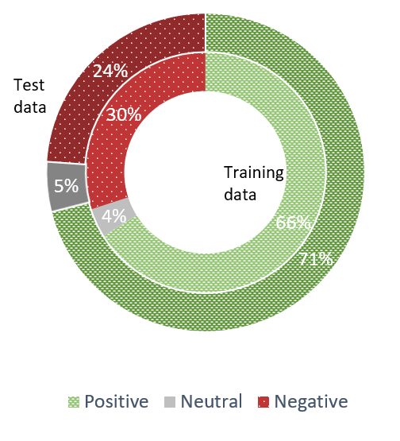
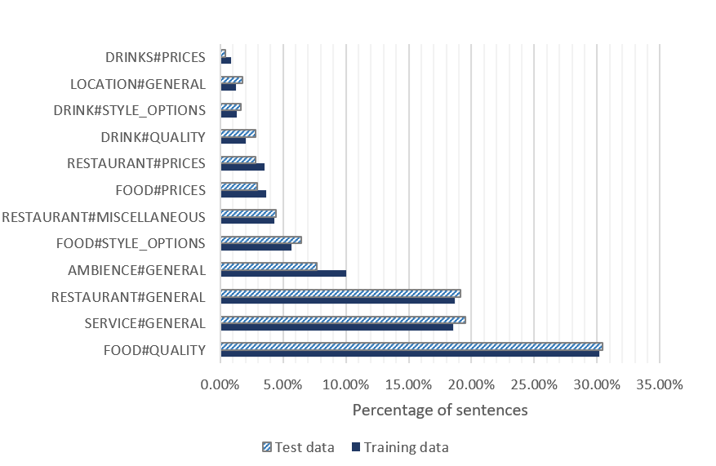
Data
Positive sentiment occurs most often
Food quality mentioned most often
Notes:
Positive sentiment occurs in 71% of the cases in the training data and 66% in the test data. Negative sentiment in 24% and 30% of the cases respectively.
Neutral sentiment almost never occurs with only 5 and 4 percent occurrence respectively.
Food quality is the dominant aspect mentioned with over 30% of the mentions being related to that. Number 2 and 3 are close to each other and relate to general restaurant and general service with about 17% each.

Slide 14
Methodology
WEB-SOBA: Word Embeddings-Based Semi-automatic Ontology Building for Aspect-Based Sentiment Classification
Implementation in Java: https://github.com/RubenEschauzier/WEB-SOBA
Gensim (Python) to train word2vec model on Yelp dataset
Word Embedding Refine (using the implementation in Python: https://github.com/wangjin0818/word_embedding_refine) to make word embeddings sentiment aware introduced by Yu et al. (2017)
Stanford CoreNLP (Java) for tokenization, lemmatization, and part-of-speech tagging
The domain ontology is represented in OWL
Notes:
We introduce Word Embeddings-Based Semi-automatic Ontology Building for Aspect-Based Sentiment Classification (WEB-SOBA). It is implemented in Java due to the well-developed environment for Semantic Web technologies. The code for training our own word2vec model on the Yelp dataset is made in Python due to the easy-to-use Gensim library. The word embeddings are refined to be sentiment aware using a method coded in python and introduced by Yu et al. (2017). Finally, to tokenize, lemmatize and POS tag the yelp dataset we use the Stanford CoreNLP package.

Slide 15
Methodology – Ontology Structure
The ontology consists of two main classes:
Mention
SentimentValue
SentimentValue consists of two subclasses
Positive
Negative
There are three types of sentiment words
Type-1: Generic sentiment always has the same polarity regardless of context, always a subclass of GenericPositive or GenericNegative class
Type-2: Sentiment word that only applies to specific category of aspects (e.g., delicious applies to food and drinks, but not to service)
Type-3: Sentiment word that changes its polarity based on what aspect it belongs to (e.g., cold beer is positive, while cold food is negative)
Notes:
The ontology consists of two main classes: The mention class and sentiment value class.
The SentimentValue class has two subclasses, postivite and negative.
There are also three types of sentiment words Type-1: Generic sentiment always has the same polarity regardless of context, always a subclass of GenericPositive or GenericNegative class Type-2: Sentiment word that only applies to specific category of aspects (e.g delicious applies to food and drinks, but not to service) Type-3: Sentiment word that changes its polarity based on what aspect it belongs to (e.g cold beer is positive, while cold food is negative)
The type-1 sentiment words are a subclass of GenericPositive or Negative, which are subclass of their respective Positive or Negative class.

Slide 16
Methodology – Ontology Structure
The Mention class has three subclasses:
ActionMention: represents verbs
EntityMention: represents nouns
PropertyMention: represents adjectives
The skeletal ontology structure is defined with a number of Mention subclasses based on entities and attributes within a domain
Predefined entities: Ambience, Location, Service, Experience, Restaurants, Food, Drinks
Predefined attributes: General, Misc, Prices, Quality, Style&Options
Entity#Attribute pairs make up categories, like Food#Quality or Drinks#Prices

Slide 17
Methodology – Ontology Structure
Each Mention class has two subclasses (where <Type> denotes Action, Entity, or Property):
GenericPositive<Type>: also a subclass of Positive
GenericNegative<Type>: also a subclass of Negative
Two types of mentions (both linked to lexical representations):
Aspect mentions (do not have associated sentiment)
Sentiment mentions (do have associated sentiment)
Sentiment mentions have associated aspects
Notes:
Example Decoration belongs to Restaurant#Style&Options, which is a subclass of EntityMention. Then if we have a word cozy we place it to belong to GenericPositive<Entity> which is a subclass of Restaurant#Style&Options. Which means that if we then get a sentence: The decoration is cozy we know cozy is a positive word when used together with decoration and classify the sentence as positive.

Slide 18
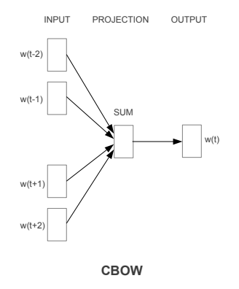
Methodology – Word Embeddings
We create our word embeddings using Word2Vec with Continuous Bag of Words (CBOW) architecture
Predict target word based on context of the word
During training the model learns semantic information
Leverage the model weights to create a dense vector
representation of an input word
Alternative is Skip-Gram, performs similarly
Notes:
We create our word embeddings using Word2Vec with Continuous Bag of Words (CBOW) architecture. During training of the model, it tries to predict the target word based on the context of the word. The context given to the model is limited to a certain window size. By trying to predict language it is able to learn a probability distribution over words that captures semantic information within its weights.
We extract these weights given an input to create a dense vector representation of an input word that contains the semantic information learned during training.
An alternative architecture is Skip-Gram, which tries to predict context based on a given target word. The performance of both architectures is about equal, but CBOW takes slightly longer to train, so we chose CBOW.

Slide 19
Methodology – Word Embeddings
Yu et al. (2017) refine vectors to include sentiment by using the Extended version of Affective Norms of English Words (E-ANEW) as a sentiment lexicon
For each word, rank the $k$ words closest the sentiment of the target word
Also rank the $k$ words based on cosine similarity to target word
Use the above rankings to adjust target word’s vector
Notes:
Word embeddings are unable to capture sentiment because words that contain opposite sentiment are usually used in the same context
Refine the vectors using E-ANEW
the vector of the target word is refined by changing it to be: (1)closer to its neighbours that are sentimentally similar, (2) further away from dissimilar neighbors,and (3) still relatively close to the original vector.
Use this new information to determine polarity of sentiment mentions within our ontology

Slide 20
Methodology – Term Selection
Extract all adjectives, nouns and verbs from Yelp data
We calculate a TermScore (TS) for each word which is composed of a DomainSimilarity (DS) and MentionClassSimilarity (MCS) score

Slide 21
Methodology – Term Selection
DS represents how domain specific a given word is, we compute it using cosine similarity
Lower is better
$DS_{i}=\frac{v_{i,D} ∙v_{i,G}}{\left|\left|v_{i,D}\right|\right|∙\left|\left|v_{i,G}\right|\right|}$,
where:
$v_{i,D}$ is the vector of word i in the domain-related word embedding model
$v_{i,G}$ the vector of word i in the general word embedding model

Slide 22
Methodology – Term Selection
MSC represents if a certain word is related to one of the base aspect mention classes of our skeletal ontology
Higher is better
$MCS_{i}=\max_{a∈A}\left(\frac{v_{i} ∙{ v}_{a} }{\left|\left|v_{i}\right|\right| ∙ |\left|v_{a}\right||}\right)$,
where:
$A$ is the set of base aspect mention classes

Slide 23
Methodology – Term Selection
The TS is the harmonic mean of the DS and MSC
$TS_{i}=\frac{2}{DS_{i} +{MSC_{i}}^{−1}}$
We select all words with a TS above a certain threshold $TH_{lc}$
$TH_{lc}=\max_{TH_{lc}}\left(\frac{2}{\frac{n}{accepted}+\frac{1}{accepted}}\right)$,
where:
$n$ is the number of suggested terms
$accepted$ is the number of accepted terms

Slide 24
Methodology – Term Selection
When a term exceeds the threshold, it is suggested to the user
If the term is accepted and a noun or verb, the user decides if it refers to an aspect or sentiment
If the term belongs to a sentiment the user must decide whether it is a Type-1 sentiment mention or not, if so, the user also decides the polarity
We select all words that have cosine similarity of 0.7 or higher to the accepted term

Slide 25
Methodology – Sentiment Term Clustering
We want to both determine the polarity of our sentiment terms and what base aspect mention class(es) the term belongs to
Calculate cosine similarity of our term to base aspect mention classes and rank them in descending order

Slide 26
Methodology – Sentiment Term Clustering
Predict polarity of sentiment words by calculating both positive and negative scores
$PS_{i}=\max_{p∈P}\left(\frac{v_{i} ∙v_{p}}{‖v_{i} ‖∙‖{ v}_{p}‖}\right)$, $NS_{i}=\max_{n∈N}\left(\frac{v_{i} ∙v_{n}}{‖v_{i} ‖∙‖{ v}_{n}‖}\right)$,
where:
$N$ is a collection of negative words with different intensities
$P$ is a collection of positive words with different intensities
N contains ‘bad’, ‘awful’, ‘horrible’, ‘terrible’, ‘poor’, ‘lousy’, ‘shitty’, ‘horrid’
P contains good’, ‘decent’, ‘great’, ‘tasty’, ‘fantastic’, ‘solid’, ‘yummy’, ‘terrific’

Slide 27
Methodology – Sentiment Term Clustering
User is recommended the highest ranked base aspect mention class for each term
If accepted, user confirms if the predicted polarity is correct, otherwise the opposite polarity is selected
Keep recommending base aspect mention classes until one is declined, then go to next term

Slide 28
Methodology – Hierarchical Clustering
First cluster aspect mentions based on what base aspect mention class they belong to
Done using adjusted k-means
The k means are fixed and are the word embeddings for the base aspect mention classes
We build a hierarchy for each subclass
Use agglomerative hierarchical clustering
All terms start in a single cluster and 2 clusters are merged in each step
Merging based on Average Linkage Clustering (ALC) between cluster $B_{1}$ and $B_{2}$
$ALC\left(B_{1}, B_{2}\right)= \frac{1}{\left|B_{1}\right|∙|B_{2}|}\sum_{x∈B_{1}}{\sum_{y∈B_{2}}{d(x,y)}}$, where $d(x,y)$ is the Euclidean distance
Notes:
We want to cluster aspect mentions based on the mention class that describes them the best. For example, Steak and fries should be a subclass of FoodMentions and coffee and tea should be a subclass of DrinksMention.
For each subclass build a hierarchy using agglomerative hierarchical clustering
We start with all Aspect mentions in the same cluster and each iteration two clusters of aspect mentions are added together
This is based on what clusters have the lowest Average Linkage clustering value. This is calculated using the average Euclidean distance between all elements within the two clusters.

Slide 29
Evaluation
 | Manual | SOBA | WEB-SOBA
Classes | 365 | 470 | 376
Lexicalizations | 750 | 2175 | 348
Synonyms | 422 | 1766 | 37
Quality Phrases | 16 | 6 | 0
Both the Manual and SOBA ontology are more extensive than our ontology
Possibly due to a stricter requirement of relevance
Notes:
As seen in the table the WEB-SOBA contains a significantly smaller number of terms than SOBA and even the Manual ontology. There are no quality phrases because are methods are not made to handle them One possible reason for this might be our stricter requirement of relevance for words. Due to the word embeddings containing more information than for example word frequencies we might be able to more accurately predict whether a term is relevant to the domain and problem.
NOTE: What are quality phrases again??

Slide 30
Evaluation
 | Manual | SOBA | WEB-SOBA
User time (minutes) | 420 | 90 | 40
Computing time (minutes) | 0 | 90 | 30 (+300)
WEB-SOBA requires significantly less human time spent than both the SOBA and Manual method
Computing time is higher due to our datasets being orders of magnitude larger
Computing time is front-loaded
Notes:
Our human time spent is significantly reduced for WEB-SOBA. We believe this to be the most important type of time spent to reduce due to it being more involved and expensive for corporations or universities.
The computing time of our method is higher, this is mainly due to our dataset containing millions of reviews compared to the 5001 reviews used for SOBA. The 300 minutes of computing time between parathesis are front-loaded. This is due to training of word-embeddings and extraction of terms from the Yelp dataset. This requires no supervision from humans.
Relatively speaking WEB-SOBA is able to handle more reviews per minute spent computing than SOBA, so it is computationally more efficient

Slide 31
Evaluation
 | Out-of-Sample Accuracy | In-Sample Accuracy | Cross-Validation Accuracy | St. dev.
Manual | 78.31% | 75.31% | 74.10% | 0.044
SASOBUS | 76.62% | 73.82% | 70.69% | 0.049
SOBA | 77.08% | 74.56% | 71.71% | 0.061
WEB-SOBA | 77.08% | 72.11% | 70.05% | 0.050
Manual + LCR-Rot-hop | 86.65% | 87.96% | 82.76% | 0.022
SASOBUS + LCR-Rot-hop | 84.76% | 83.38% | 80.20% | 0.031
SOBA + LCR-Rot-hop | 86.23% | 85.93% | 80.15% | 0.039
WEB-SOBA + + LCR-Rot-hop | 87.16% | 88.87% | 84.72% | 0.043
Accuracies for Manual ontology is highest without back-up model
With back-up LCR model WEB-SOBA performs best
Notes:
We have used the SemEval 2016, Task 5, Subtask 1, Slot 3 dataset for restaurants to evaluate the quality of the built ontologies using the Two-Step Hybrid approach for ABSA at sentence-level proposed by Schouten and Frasincar in 2018.
In this table one can see the out-of-sample accuracy, the in-sample accuracy and the cross-validation accuracy and standard deviation for only the ontology and the Two-Step Hybric approach with LCR-Rot-hop as backup model.
Here the names denote the type of ontology used for the main classifier. We can see that the accuracy of the Manual ontology is highest when only using an ontology. However, when we also use LCR as back-up we find that WEB-SOBA performs best. This is possibly due to the WEB-SOBA ontology better covering the weaknesses of the LCR method and vice versa.

Slide 32
Conclusion
We proposed WEB-SOBA: Word Embeddings-Based Semi-automatic Ontology Building for Aspect-Based Sentiment Classification
Embedding Learning
Term Selection
Sentiment Clustering
Hierarchical Clustering
We have used two restaurant datasets in our evaluation:
Yelp Dataset Challenge data for ontology building
SemEval 2016, Task 5, Subtask 1, Slot 3 data for measuring performance

Slide 33
Conclusion
Similar performance to other semi-automatically built ontologies when used without back-up model
Increased accuracy by ~2% when used with state-of-the-art LCR-Rot-hop model compared to manually made ontology (cross-validation)
Increase accuracy by ~4% when used with state-of-the-art LCR-Rot-hop model compared to other semi-automatically built ontologies (cross-validation)
Significantly reduces human time spent
More efficient in computing than previous works, but requires more data
Future work:
Use deep contextualized word embeddings (e.g. BERT)
Exploit both synsets and word embeddings

Slide 34
References
Buitelaar, P., Cimiano, P., & Magnini, B. (2005). Ontology learning from text: An overview. Ontology learning from text: Methods, evaluation and applications, IOS Press
Dera, E., Frasincar, F., Schouten, K., & Zhuang, L. (2020). SASOBUS: Semi-automatic sentiment domain ontology building using synsets. In 17th Extended Semantic Web Conference (pp. 105-120). Springer
Schouten, K., Frasincar, F., & de Jong, F. (2017). Ontology-enhanced aspect-based sentiment analysis. In International Conference on Web Engineering (pp. 302-320). Springer
Truşcǎ, M. M., Wassenberg, D., Frasincar, F., & Dekker, R. (2020). A hybrid approach for aspect-based sentiment analysis using deep contextual word embeddings and hierarchical attention. In International Conference on Web Engineering (pp. 365-380). Springer

Slide 35
References
Yu, L. C., Wang, J., Lai, K. R., & Zhang, X. (2017). Refining word embeddings for sentiment analysis. In 2017 Conference on Empirical Methods in Natural Language Processing (pp. 534-539), ACL.
Zhuang, L., Schouten, K., & Frasincar, F. (2020). SOBA: Semi-automated ontology builder for aspect-based sentiment analysis. Journal of Web Semantics, 60, 100544
Notes:
And these are my references, Thank you for your attention and if you have any questions do not hesitate to ask me

