Slide 1
Ontology-Driven Sentiment Analysis of Product and Service Aspects
Kim Schouten and Flavius Frasincar

Slide 2
Problem statement
What sentiment is expressed about which aspect of a given entity?
Usually only look at polarity: is it positive, neutral, or negative?
SemEval-2015/2016 ABSA task data
  Reviews are split in sentences
  Sentences are annotated with aspects
  For each aspect, determine positive/negative/neutral
Can we do this task using an ontology, and not just as a glorified sentiment lexicon?
Notes:
Lexalytics, Brandwatch, startups: Wonderflow, Vita.io

Slide 3
Role of ontology
Previous work used ontology to get additional features to improve a classifier
Hard to interpret results
What if we used just the ontology to infer sentiment?
  Results are 100% explainable
  Ontology has to be large enough (which it isn’t)
To cover for the small ontology size, we also train a bag-of-words classifier
  Used when ontology does not provide conclusive evidence
    No sentiment words at all
    Both positive and negative words

Slide 4
Aspect-based sentiment analysis
What sentiment is expressed about which aspect of a given entity?
Usually only look at polarity: is it positive, neutral, or negative?
Economically interesting task for, e.g.,
  consumers when making a purchase decision
  producers to assess the impact of marketing campaigns, success of product launches, etc.
Academically interesting because polarity is not always easy to measure
  Context-dependence
  Common expressions
  Irony
Notes:
Lexalytics, Brandwatch, startups: Wonderflow, Vita.io

Slide 5
Data snippet ABSA task @ SemEval-2016/2015
<sentence id="1032695:1">
<text>Everything is always cooked to perfection , the service is excellent , the decor cool and understated .</text>
<Opinions>
<Opinion target="NULL" category="FOOD#QUALITY" polarity="positive" from="0" to="0"/>
<Opinion target="service" category="SERVICE#GENERAL" polarity="positive" from="47" to="54"/>
<Opinion target="decor" category="AMBIENCE#GENERAL" polarity="positive" from="73" to="78"/>
</Opinions>
</sentence>

Slide 6
Data Snippet
<sentence id="1032695:1">
<text>Everything is always cooked to perfection , the service is excellent , the decor cool and understated .</text>
<Opinions>
<Opinion target="NULL" category="FOOD#QUALITY" polarity="positive" from="0" to="0"/>
<Opinion target="service" category="SERVICE#GENERAL" polarity="positive" from="47" to="54"/>
<Opinion target="decor" category="AMBIENCE#GENERAL" polarity="positive" from="73" to="78"/>
</Opinions>
</sentence>

Slide 7
Data Snippet
<sentence id="1032695:1">
<text>Everything is always cooked to perfection , the service is excellent , the decor cool and understated .</text>
<Opinions>
<Opinion target="NULL" category="FOOD#QUALITY" polarity="positive" from="0" to="0"/>
<Opinion target="service" category="SERVICE#GENERAL" polarity="positive" from="47" to="54"/>
<Opinion target="decor" category="AMBIENCE#GENERAL" polarity="positive" from="73" to="78"/>
</Opinions>
</sentence>

Slide 8
Data Snippet
<sentence id="1032695:1">
<text>Everything is always cooked to perfection , the service is excellent , the decor cool and understated .</text>
<Opinions>
<Opinion target="NULL" category="FOOD#QUALITY" polarity="positive" from="0" to="0"/>
<Opinion target="service" category="SERVICE#GENERAL" polarity="positive" from="47" to="54"/>
<Opinion target="decor" category="AMBIENCE#GENERAL" polarity="positive" from="73" to="78"/>
</Opinions>
</sentence>
Task: Aspect Detection

Slide 9
Data Snippet
<sentence id="1032695:1">
<text>Everything is always cooked to perfection , the service is excellent , the decor cool and understated .</text>
<Opinions>
<Opinion target="NULL" category="FOOD#QUALITY" polarity="positive" from="0" to="0"/>
<Opinion target="service" category="SERVICE#GENERAL" polarity="positive" from="47" to="54"/>
<Opinion target="decor" category="AMBIENCE#GENERAL" polarity="positive" from="73" to="78"/>
</Opinions>
</sentence>

Slide 10

Ontology

Slide 11
Purpose of ontology
Sentiment lexicon
  Aspect and sentiment concepts have lexicalizations
    Link classes to words in text
  High-level aspect concepts have an aspect annotation
    Link classes to ‘aspect category’ annotations in data set
  Sentiment words that are always positive are subclasses of the Positive class
  Same for Negative, no Neutral class.
  Sentiment words that have the same sentiment value, regardless of aspect are called type-1 sentiment words in the paper.

Slide 12
Data Snippet
<sentence id="1032695:1">
<text>Everything is always cooked to perfection , the service is excellent , the decor cool and understated .</text>
<Opinions>
<Opinion target="NULL" category="FOOD#QUALITY" polarity="positive" from="0" to="0"/>
<Opinion target="service" category="SERVICE#GENERAL" polarity="positive" from="47" to="54"/>
<Opinion target="decor" category="AMBIENCE#GENERAL" polarity="positive" from="73" to="78"/>
</Opinions>
</sentence>

Slide 13
Purpose of ontology
Sentiment lexicon
Sentiment scope
  Some sentiment words are only ever used for a single aspect category
  These classes have this aspect class as an extra superclass
  Sentiment word will not be used to determine sentiment for other aspect categories
  For example:
    “noisy” implies the “ambience” aspect in the restaurant domain
    If the sentence also has the “food” aspect to compute sentiment for, “noisy” will be ignored
  In the paper, these are called type-2 sentiment words

Slide 14
Purpose of ontology
Sentiment lexicon
Sentiment scope
Context-dependent sentiment
  The same sentiment word can have a different polarity for different aspects
  “For such a high price, the quality is indeed high, as expected.”
  This is modeled in the ontology using class axioms and referred to as type-3
  Quality and High SubclassOf Positive
  Price and High SubclassOf Negative
  Creating a subclass of both aspect and sentiment class will trigger the axiom
  Reasoner will infer the right sentiment class

Slide 15
Ontology class hierarchy

Slide 16
Sentiment classification

Slide 17
Sentiment classification
The ontology (Ont) method uses a very simple mechanism to compute sentiment
  For each aspect, get all sentiment concepts in the sentence
  For each sentiment concept, check type
    If type-1: save superclasses in set
    If type-2: save superclasses only when aspect matches
    If type-3:
      for each directly related word that is the lexicalization of an aspect class;
      make a new subclass with both aspect and sentiment class as superclasses;
      save superclasses of this new class
  In case a negation is found then flip the sentiment
    Negator word in preceding 3 words or a ‘neg’ relation
  Set of superclasses hopefully includes the Positive or Negative class

Slide 18
Sentiment classification
If set contains only Positive -> predict “positive”
If set contains only Negative -> predict “negative”
If set contains both or none, the ontology method cannot do much
We experimented with counting Positive and Negative and picking the highest, but that did not improve performance.
In case the method is inconclusive we can do two things:
  Predict majority class (Positive) (Ont method in paper)
  Use a bag-of-words model to predict sentiment (Ont+BoW method in paper)

Slide 19
The bag-of-words model
Simple model using as features:
  The presence of words in the whole review
  The aspect category of the current aspect
  The sentiment value of the sentence as computed by the CoreNLP sentiment module
Classifier is the standard Weka SVM model with RBF kernel and optimized hyperparameters

Slide 20
The alternative bag-of-words model (BoW+Ont)
Basic bag-of-words model augmented with ontology features
Use ontology method to find the classes for a given aspect
If it only contains Positive, add Positive to the feature set
In this way it has the same information as the two-stage Ont+Bow method

Slide 21
Results

Slide 22
Sentiment distribution (2016 data set)
Notes:
Use decision tree to find triggers for neutral case.

Slide 23
Results
SemEval-2015 data
 | Out-of-sample accuracy | In-sample accuracy | 10-fold cv accuracy | 10-fold cv st.dev.
Ont | 63.3% | 79.4% | 79.3% | 0.0508
BoW | 80.0% | 91.1% | 81.9% | 0.0510
Ont+BoW | 82.5% | 89.9% | 84.2% | 0.0444
BoW+Ont | 81.5% | 91.7% | 83.9% | 0.0453
All averages are statistically significant, except Ont+BoW vs. BoW+Ont

Slide 24
Results
SemEval-2016 data
 | Out-of-sample accuracy | In-sample accuracy | 10-fold cv accuracy | 10-fold cv st.dev.
Ont | 76.1% | 73.9% | 74.2% | 0.0527
BoW | 82.0% | 90.0% | 81.9% | 0.0332
Ont+BoW | 86.0% | 89.3% | 84.3% | 0.0319
BoW+Ont | 85.7% | 90.4% | 83.7% | 0.0370
All averages are statistically significant

Slide 25
Data size sensitivity analysis (SemEval-2015 data)
Keep the test set the same
Use only n% of
available training data
Set n to 10:100 with
step size 10

Slide 26
Data size sensitivity analysis (SemEval-2016 data)
Keep the test set the same
Use only n% of
available training data
Set n to 10:100 with
step size 10

Slide 27
Performance of Ont and BoW per scenario
Ontology method is only used when it finds just Positive or just Negative
Bag-of-words model is only used in the remaining cases
Measure performance for each of the scenarios
SemEval-2016 data
 | size | Ontology accuracy | Bag-of-words accuracy
Found only Positive | 42.7% | 88.1% | 83.7%
Found only Negative | 9.8% | 94.0% | 85.5%
Found both | 4.3% | 47.2% | 52.8%
Found none | 43.2% | 33.4% | 77.3%

Slide 28
Conclusions &
Future Work

Slide 29
Conclusions
Ontology method and bag-of-words method complement each other
Good hybrid performance
Performance of pure ontology method is low due to lack of coverage
However, when applicable
  Gives good performance
  Explainable results
  No training data necessary
Of course…good domain ontologies do not appear instantly either…

Slide 30
Future Work
Automate ontology population
  We currently have a semi-automatic approach that provides suggestions for ontology population
Include multi-word sentiment expressions
  “The food here is out of this world.”
Investigate best way to combine sentiment and distance information
  Currently just one step in dependency graph, but not really investigated
Improve speed
  The Jena library rebuilds the full inference model every time a class is added
  Solved a bit by caching, but not pretty

Slide 31
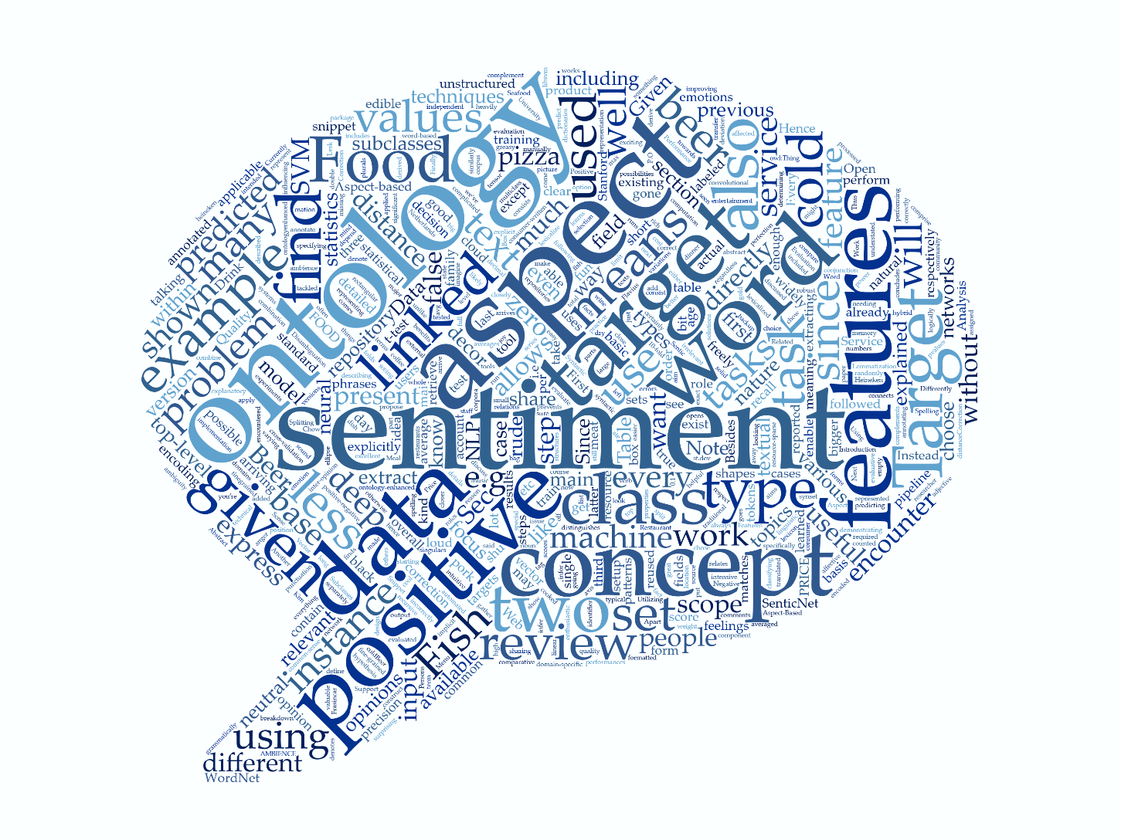
Questions?
https://github.com/KSchouten/Heracles

